Slide 1
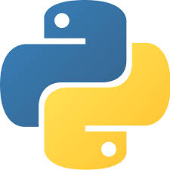
Exceptions - Python

Slide 2
Exceptions - Python
An exception can be defined as an abnormal condition in a program. It interrupts the flow of the program.
Whenever an exception occurs, the program halts the execution, and thus the further code is not executed.
In general an exception is an error that happens during execution of a program. When that error occurs, it terminates program execution.
In Python, an error can be a syntax error or an exception. Now we will see what an exception is and how it differs from a syntax error

Slide 3
Standard Exceptions - Python
Standard Exceptions in Python:
Python supports various built-in exceptions, the commonly used exceptions are
NameError: It occurs when a name is not found.i.e attempt to access an undeclared variable
ZeroDivisionError: Occurs when a number is divided by zero.
ValueError: Occurs when an inappropriate value assigned to variable.

Slide 4
Standard Exceptions - Python
Standard Exceptions in Python:
Python supports various built-in exceptions, the commonly used exceptions are
IndexError: Occurs when we request for an out-of-range index for sequence.
KeyError: Occurs when we request for a non-existent dictionary key
FileNotFoundError : Occurs when we request for a non-existent input/output file.

Slide 5
Exception handling - Python
Exception handling in python:
Python provides us with the way to handle the Exception so that the other part of the code can be executed without any interrupt.
For Exception handling, python uses following keywords or statements
try
except
else
finally
raise
assert

Slide 6
Exception handling - Python
try – except statement:
If the python program contains suspicious code that may throw the exception, we must place that code in the try block.
The try block must be followed with the except statement which contains a block of code that will be executed if there is some exception in the try block.
Syntax:
try:
#block of code
except Exception1:
#block of code
except Exception2:
#block of code
#other code

Slide 7
Exception handling - Python
try – except-else statement:
We can also use the else statement with the try-except statement in which, we can place the code which will be executed if no exception occurs in the try block.
Syntax:
try:
#block of code
except Exception1:
#block of code
else:
#executes if no except block is executed
#other code

Slide 8
Exception handling - Python
finally statement:
We can use the finally block with the try block in which, we can place the important code which must be executed either try throws an exception or not.
Syntax:
try:
#block of code
except Exception1:
#block of code
else:
#executes if no except block is executed
finally:
# this code will always be executed

Slide 9
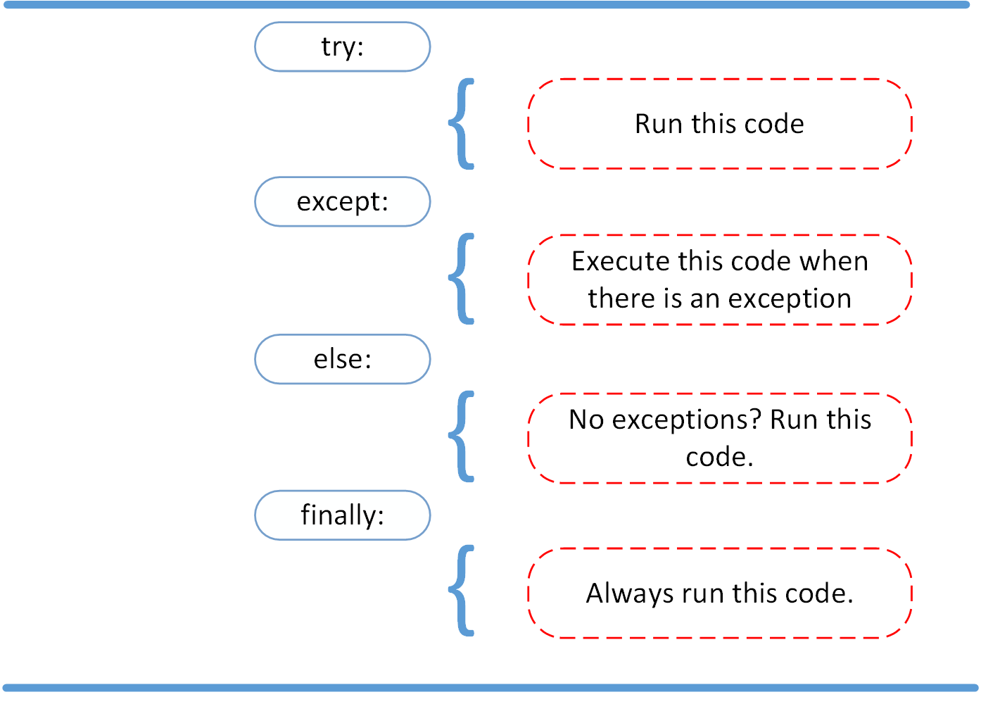
Exception handling - Python

Slide 10
Exception handling - Python
raise statement (or) Raising exceptions:
We can use raise to throw an exception if a condition occurs. i.e. If you want to throw an error when a certain condition occurs we can use raise keyword.
Syntax:
raise Exception_class

Slide 11
Exception handling - Python
assert statement (or) Assertions:
Assertions are simply Boolean expressions that checks if the conditions return true or not. If it is true, the program does nothing and moves to the next line of code. However, if it's false, the program stops and throws an error.
Python has built-in assert statement to use assertion condition in the program. assert statement has a condition or expression which is supposed to be always true. If the condition is false assert halts the program and gives an AssertionError.
Syntax:
assert condition [, error_message]

Slide 12
Exception handling - Python
Creating Exceptions:
Python allow programmers to create their own exception class. Exceptions should typically be derived from the Exception class, either directly or indirectly.
In the following example, we create custom exception class UnderAge that is derived from the base class Exception.
Syntax:
class User_Excep_Name(Exception):
#code

